Slide 1
Clustering
Sam D. Lojacono, Seth Adams, Kiana Herr, David Moste, Joel Bianchi, Maxwell Yearwood
Notes:
MAXWELL

Slide 2
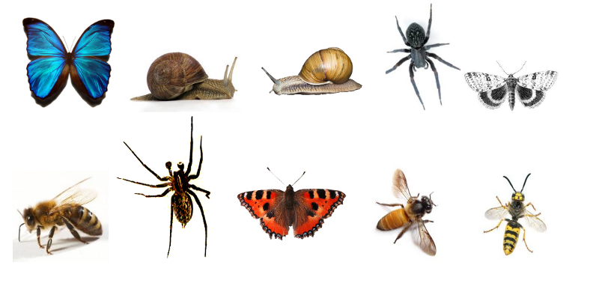
How many different groups of creepy-crawlies do you see?
A
B
C
D
E
F
G
H
I
J
Notes:
MAXWELL
https://www.freecodecamp.org/news/how-machines-make-sense-of-big-data-an-introduction-to-clustering-algorithms-4bd97d4fbaba/
There are 115,975 ways to cluster 10 items!

Slide 3
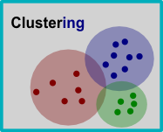
What is Clustering?
Clustering is the process of dividing a dataset into groups in such a way that data points in the same cluster are similar to each other and different from those in other clusters
Clustering is used in machine learning and data science to group similar data points together.
The goal of clustering is to identify patterns in the data and group them into meaningful clusters.
Notes:
DAVID

Slide 4
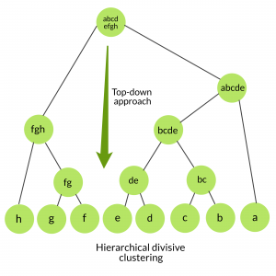
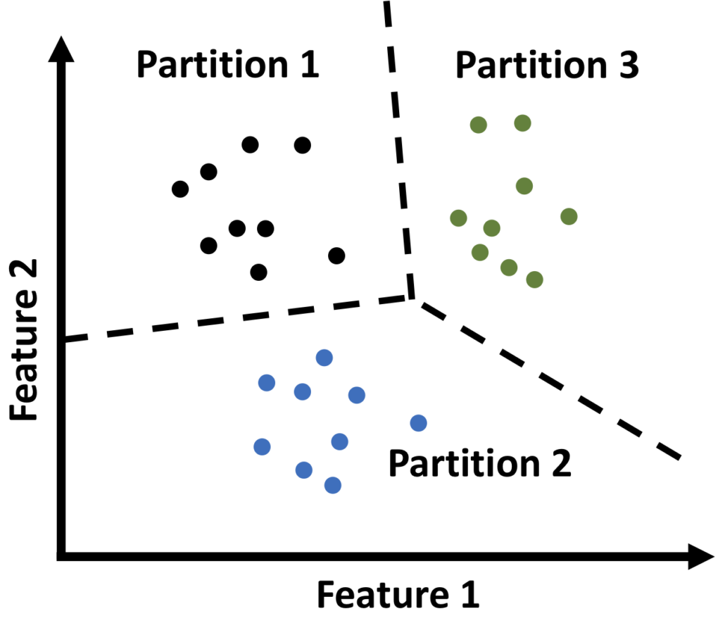
Types of Clustering
There are two main types of clustering algorithms – hierarchical clustering and partitional clustering.
Hierarchical clustering involves creating a tree-like structure of clusters, where smaller clusters are merged or nestled into larger ones.
Partitional clustering involves dividing the data points into non-overlapping clusters, where each data point belongs to exactly one cluster.
Notes:
DAVID

Slide 5
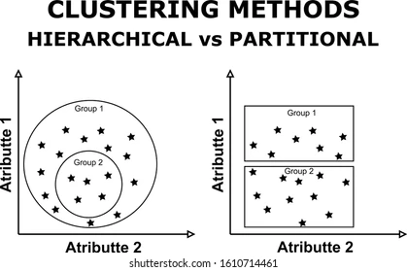
Types of Clustering
Notes:
DAVID

Slide 6
Types of Clustering
Notes:
DAVID

Slide 7
Types of Clustering
Notes:
DAVID

Slide 8
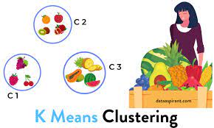
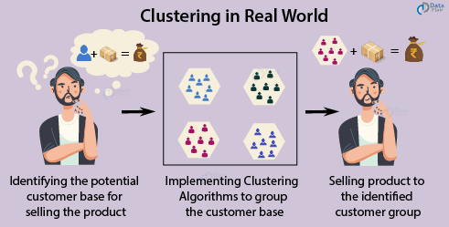
Applications of k-Means Clustering
Image segmentation and compression
Customer segmentation in marketing
Document clustering in natural language processing
Anomaly detection in cybersecurity
Simple and efficient technique for finding groups of similar observations in large and high-dimensional data sets
Notes:
MAXWELL

Slide 9
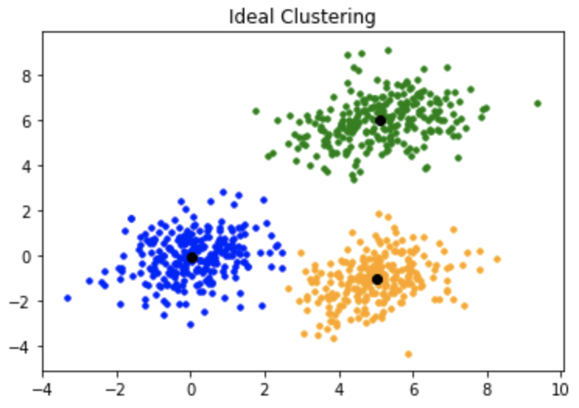
What is k-Means Clustering?
A method of partitioning observations into clusters
Clusters are characterized by their centroids, which serve as markers for the members of the cluster
Each observation belongs to the cluster with the nearest mean (cluster centers or centroid)
Notes:
MAXWELL
Princeton paper: https://www.cs.princeton.edu/courses/archive/fall18/cos324/files/kmeans.pdf

Slide 10
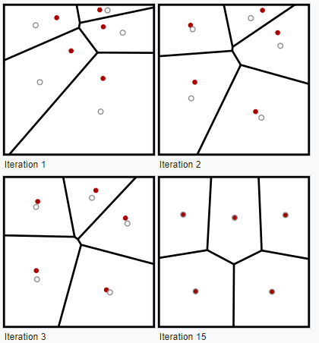
The Iterative Refinement Technique
The most common algorithm for k-means clustering
Also known as "Lloyd's algorithm" or "naïve k-means"
Alternates between assigning data points to the nearest cluster and recomputing the cluster means
Converges when the centroids no longer change
Notes:
SETH

Slide 11
Steps to the K-means Clustering Algorithm
Choose the number of clusters to form (k)
Randomly select k observations and assign them as the initial centroids
Assign each observation to the nearest centroid using a distance measure
Recalculate the centroids of each cluster as the mean of all observations in that cluster
Repeat steps 3 and 4 until convergence
Notes:
SETH

Slide 12

Limitations of k-Means Clustering
Does not guarantee to find the optimum solution
Determining the optimal number of clusters can be subjective or based on external criteria
Notes:
SETH

Slide 13




“Notebooks”: Popular Data Science Tools
Type Python blocks & MD blocks in a .ipynb file
Type Python in a .py file
“Notebook” for Python code that allows testing small bits at a time
Language we are programming in
Free online coding environment that can handle Python notebooks
Free online coding environment for Python
Code-Along Starter Code Notebook
Notes:
JOEL
Colab basics: https://ito-engineering.screenstepslive.com/s/ito_fase/a/1269075-using-google-colab-for-a-coding-activity-prof-sinisa-colic#collab-basics
Code-Along Starter Code: https://colab.research.google.com/drive/1zyd2QnOjq46bJC1fbHVqmnkxpJGdOc94?usp=sharing

Slide 14
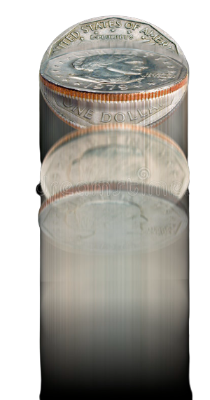

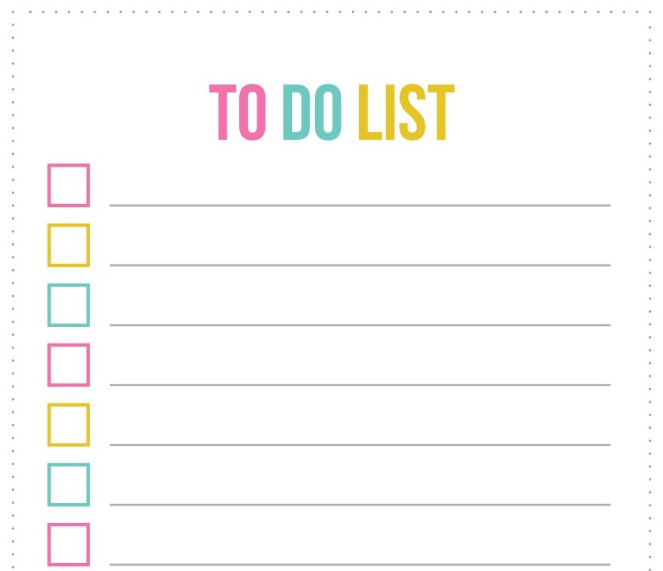

CODE-ALONG
ROOM 1
Flip a Coin
Join a Room
Open Copy of Starter Code Notebook
Code along!
CLICK TO FLIP A COIN!
ROOM 2
Notes:
JOEL & KIANA

Slide 15


Intro to Scikit Learn
Machine learning package for python
Heavily used in data science
Has built-in methods for various classification, regression, and clustering algorithms
Also has built-in methods for the undersides of data science as well (preprocessing)
Notes:
DAVID

Slide 16
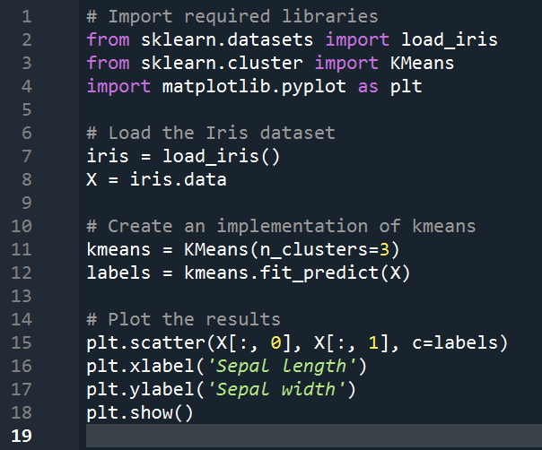
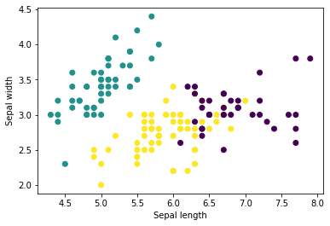
Scikit Learn Code
Notes:
DAVID

Slide 17
Scikit Learn Code
These lines import both the kmeans algorithm and a prepackaged dataset from scikit learn
Notes:
DAVID

Slide 18
Scikit Learn Code
These lines bring the iris dataset into the working code
Notes:
DAVID

Slide 19
Scikit Learn Code
These lines of code run the entire algorithm we just worked on…
Notes:
DAVID

Slide 20
Scikit Learn Code
These lines print out the plot shown below
Notes:
DAVID

Slide 21
Homework Options
Click Here for Homework
Notes:
SAM
Homework Link: https://docs.google.com/document/d/1DOjbxnJMobmIxAGE42Y2IEFnrx06vtqxQLQNbbbLNrs/edit?usp=sharing
Finished Code-Along Link: https://colab.research.google.com/drive/1FspVjpwhy_8sDw8Tf9ugWy6E4AXOMJAw?usp=sharing

